Slide 1
SUPERSTORE DATA

Slide 2
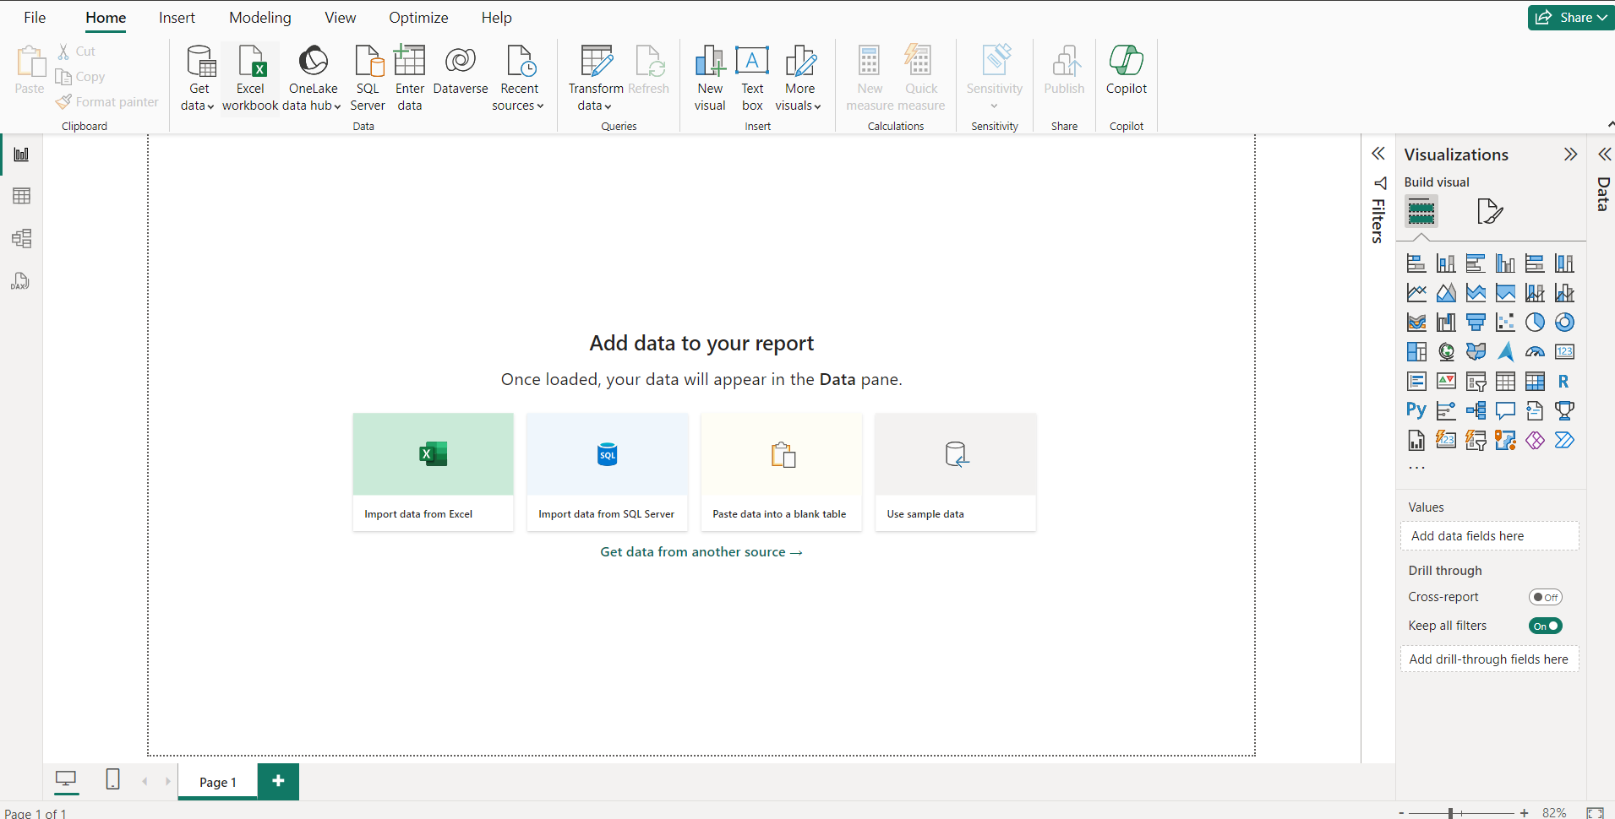
IMPORT DATA
Open Power BI
Select import data from excel.
Select file and open the data.
Then click the sheet 1 check box and click transform data.

Slide 3
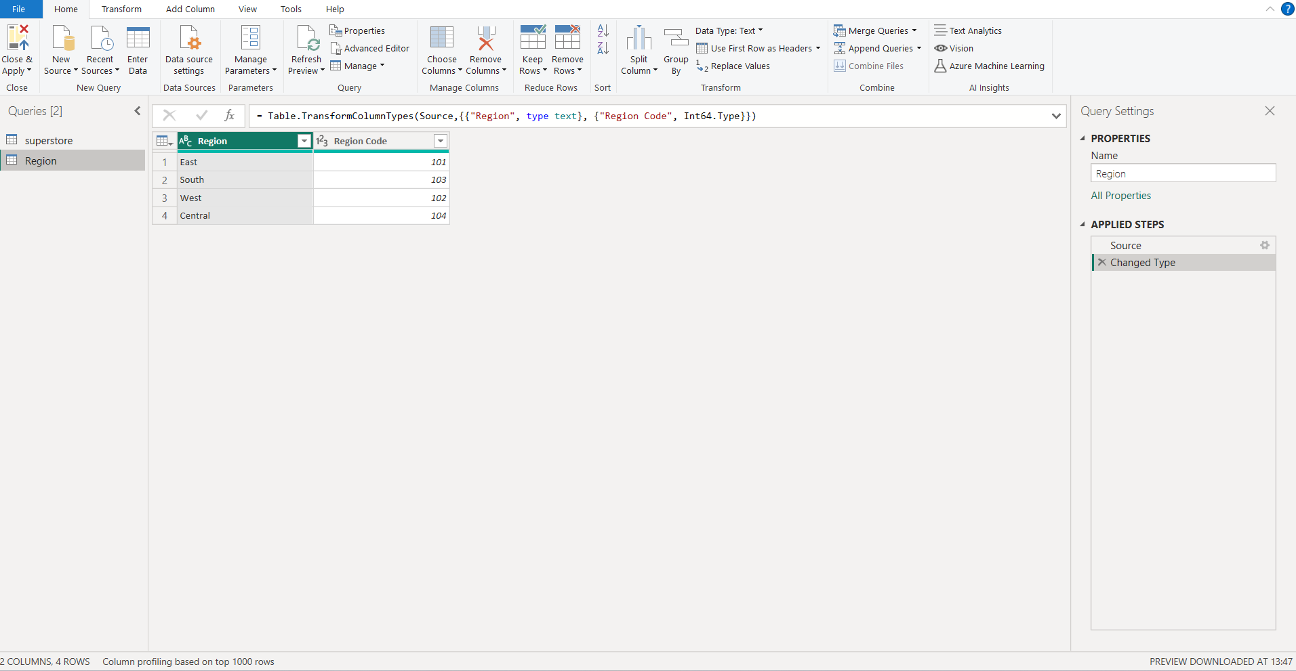
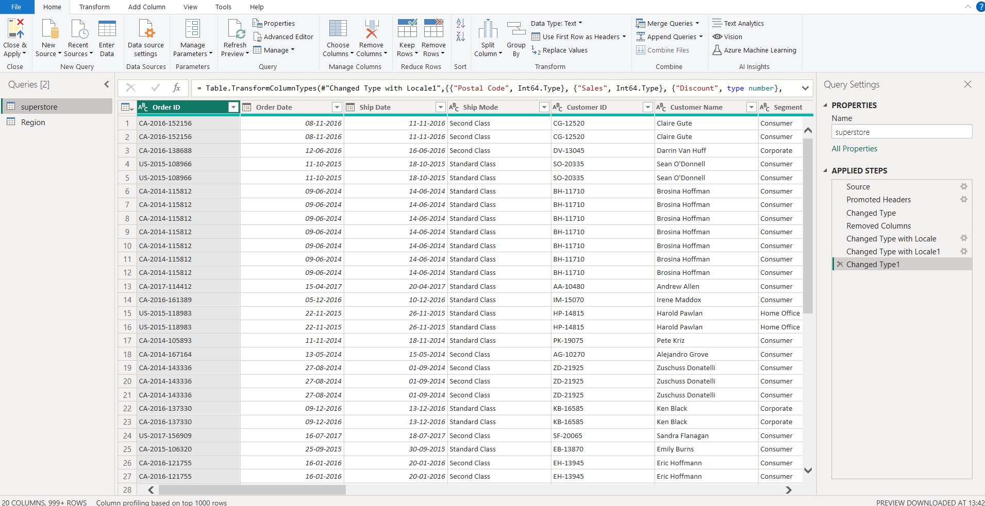
TRANSFORM DATA
We can change the type of data and modify here.
Here we remove the columns and changed type with locale.
We can view the changes we done in the right side.
Next select enter table and create a new table.
Finally select close and apply to save the changes.

Slide 4
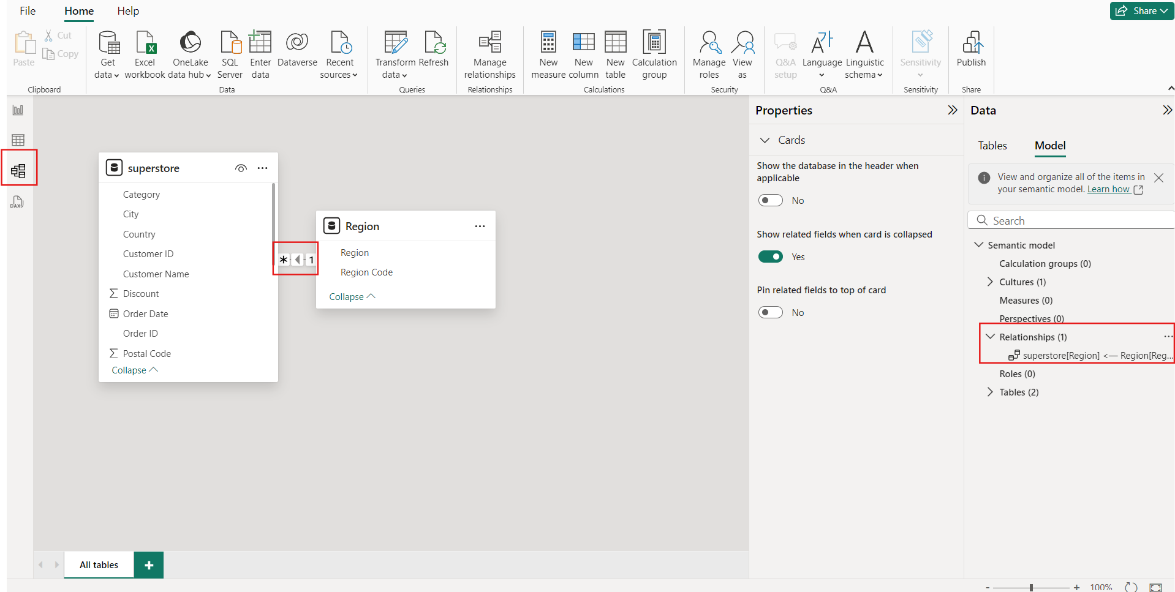
RELATIONSHIP
We click the model view and see the relationship between superstore and region.
There is one relationship.

Slide 5
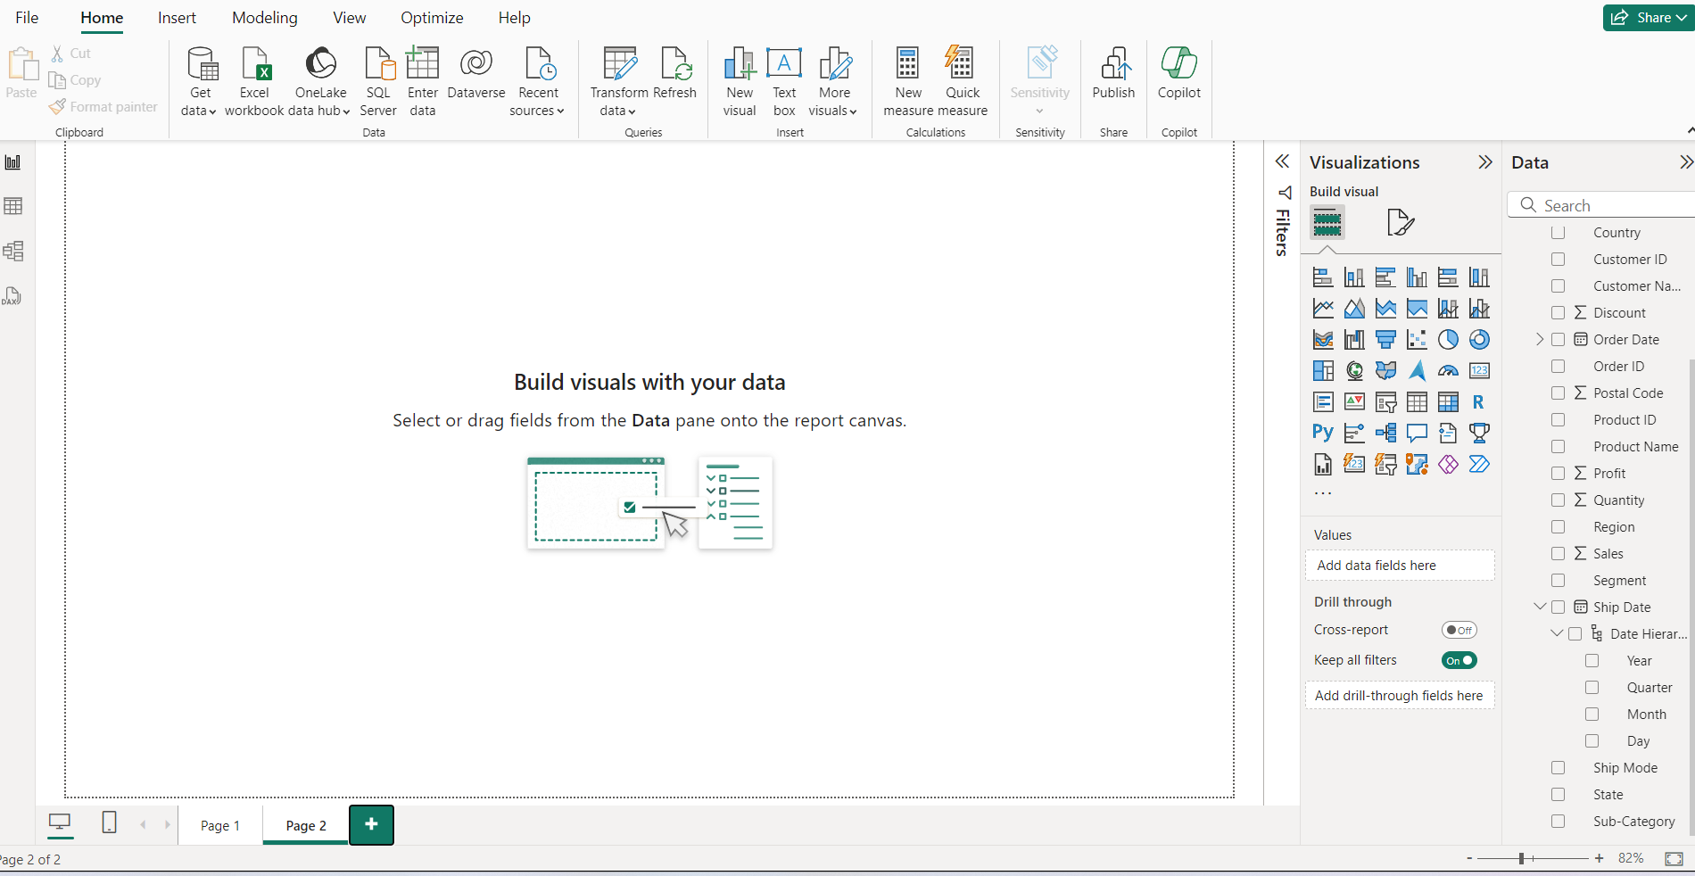
VISUALIZATION
Now, we get the data.
Next, we create the visualization.
Click Home → New visual.
Then select the type of visual from the visualizations.

Slide 6
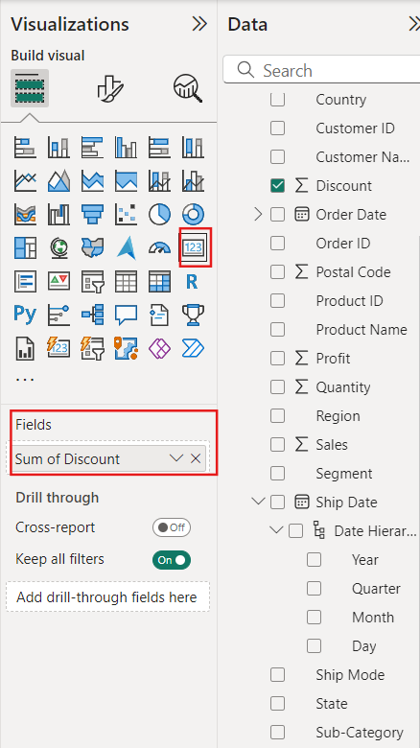
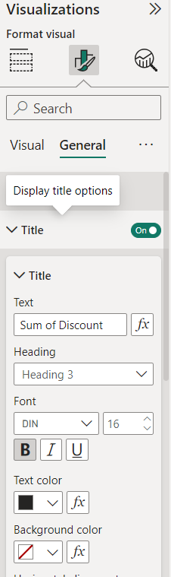

SUM OF DISCOUNT
First we click cards from the visualization and sum of discount in fields.
Then change the format from the format visual.

Slide 7
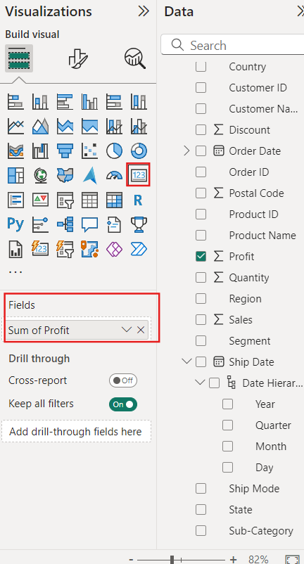
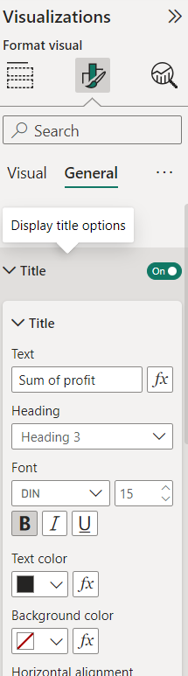

SUM OF PROFIT
We click cards from the visualization and sum of applicant income in fields.
Then change the format from the format visual.

Slide 8
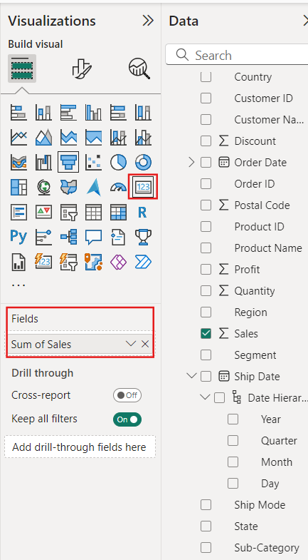
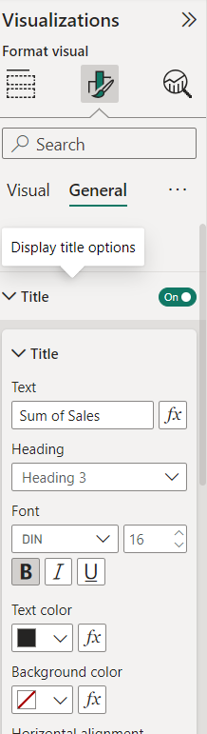

SUM OF SALES
We click cards from the visualization and sum of applicant income in fields.
Then change the format from the format visual.

Slide 9
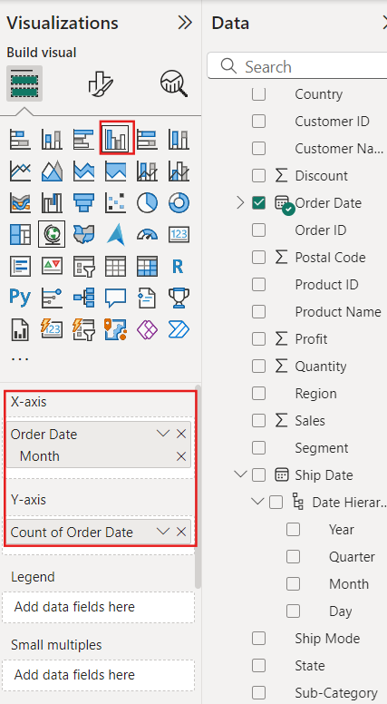
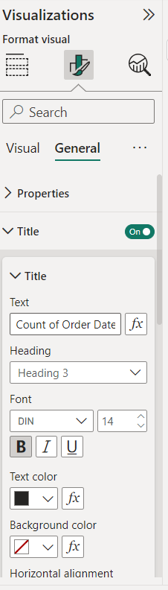
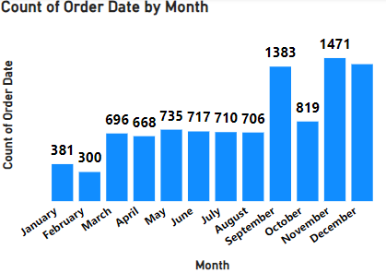
COUNT OF ORDER DATE BY MONTH
We select clustered column chart.
Then drag month of order date in x axis and count of order date in y axis.
We can change the format of the visual.

Slide 10
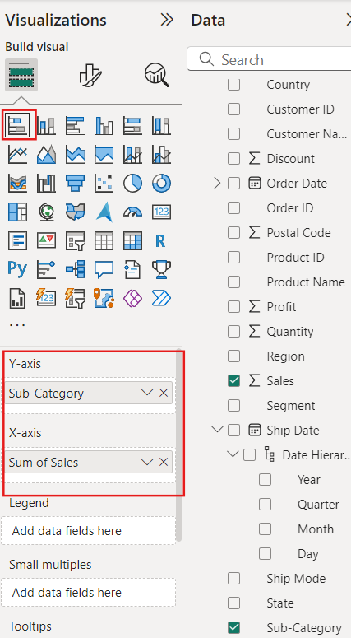
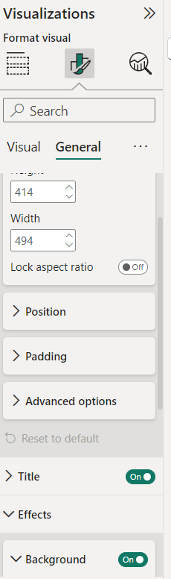
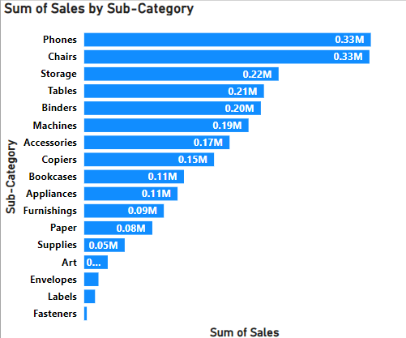
SUM OF SALES BY SUB-CATEGORY
We select stacked bar chart.
Then drag sub category in the y axis and sum of sales in x axis.
We can change the format of the visual.

Slide 11
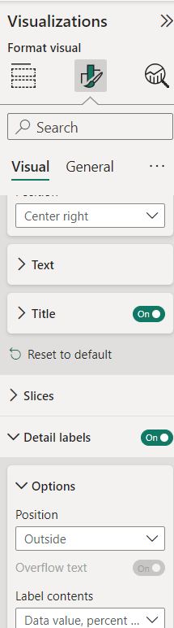
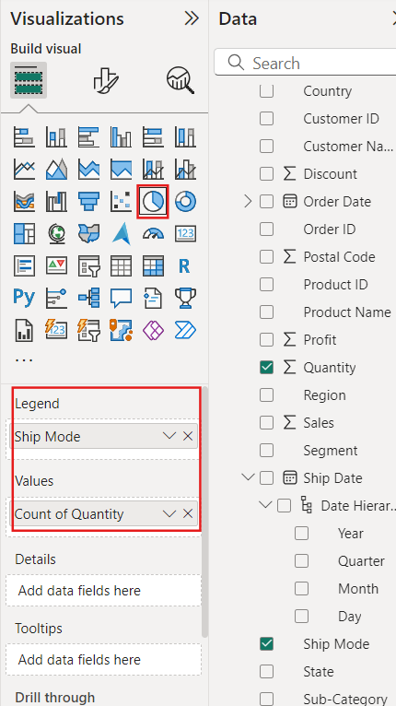
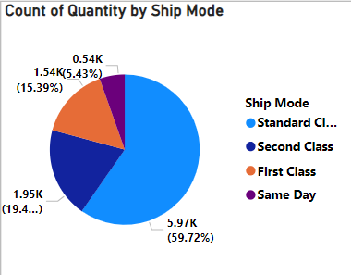
COUNT OF QUANTITY BY SHIP MODE
We select pie chart.
Then drag ship mode in legend and count of quantity in values.
We can change the format of the visual.

Slide 12
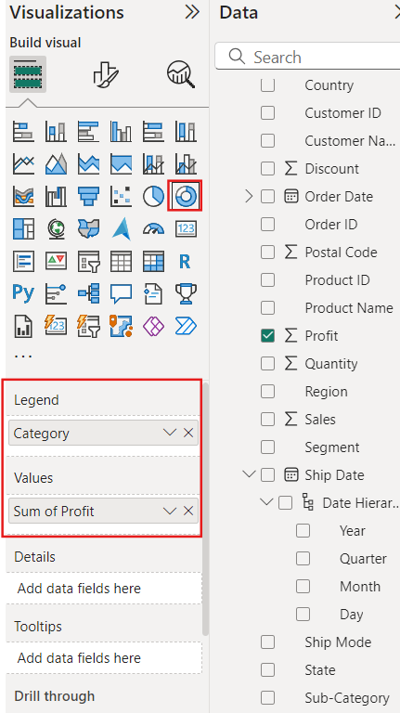
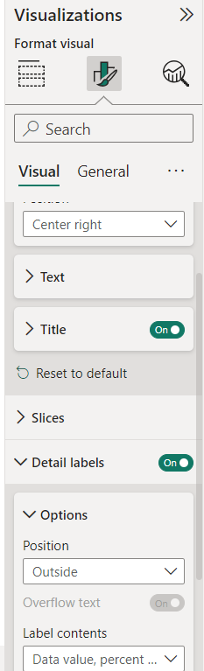
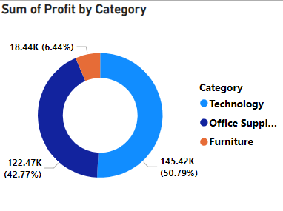
SUM OF PROFIT BY CATEGORY
We select Doughnut chart.
Then drag category in legend and sum of profit in values.
We can change the format of the visual.

Slide 13
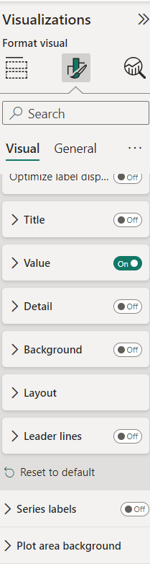
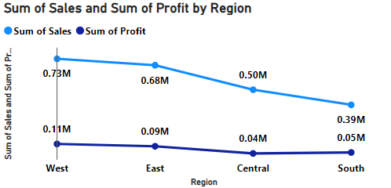
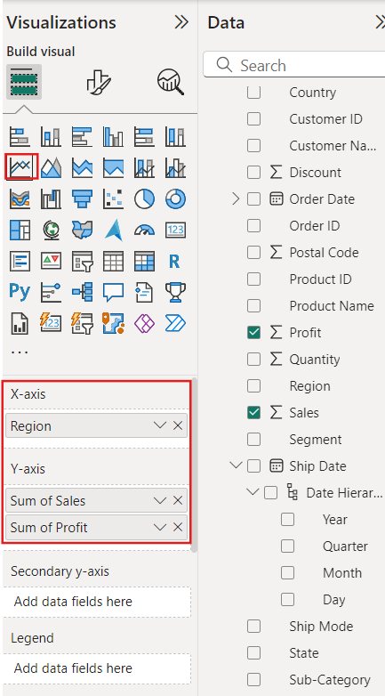
SUM OF SALES AND SUM OF PROFIT BY REGION
We select line chart.
Then drag region in x axis and sum of sales and sum of profit in y axis.
We can change the format of the visual.

Slide 14
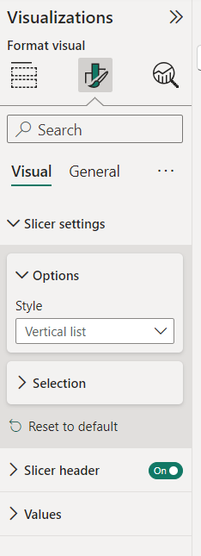
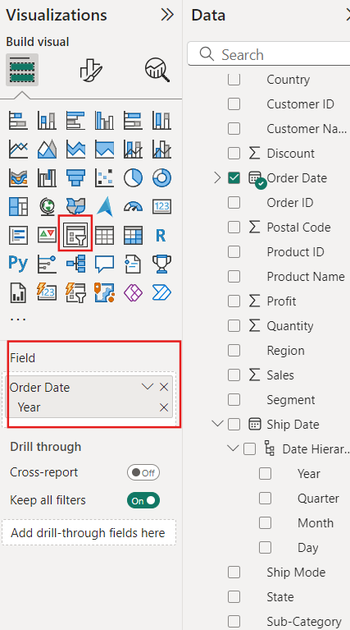
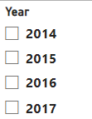
YEAR SLICER
Now, we create a slicer.
Select slicer in visualizations, then year of order date in the field.
Format visual → Slicer settings → options → style → vertical list.

Slide 15
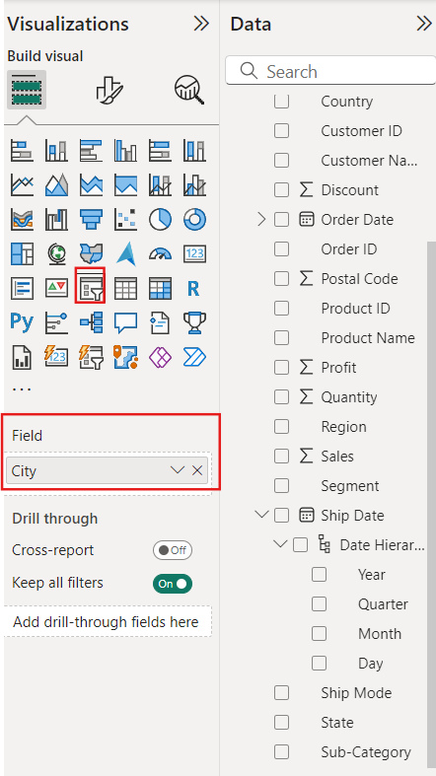
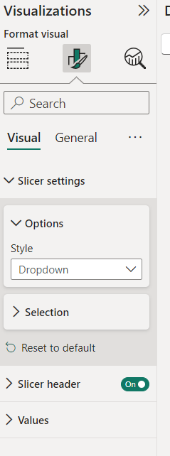

CITY SLICER
Now, we create a slicer.
Select slicer in visualizations, then drag city in the field.
Format visual → Slicer settings → options → style → dropdown.

Slide 16

TITLE
Now, we add title.
Click Home → Text box
Type the text and we can change the size, font and color and background of the text.

Slide 17
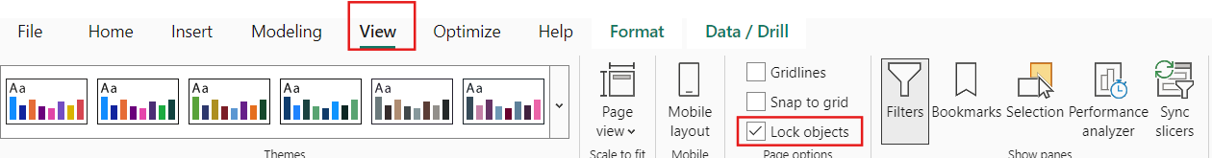
LOCK OBJECT
Then click view options and select lock objects so that the visualizations cannot move.

Slide 18
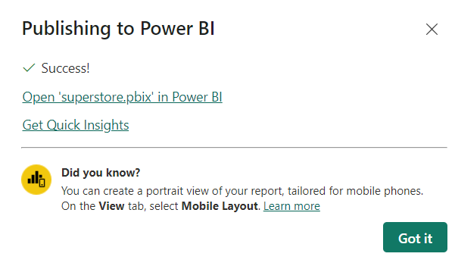
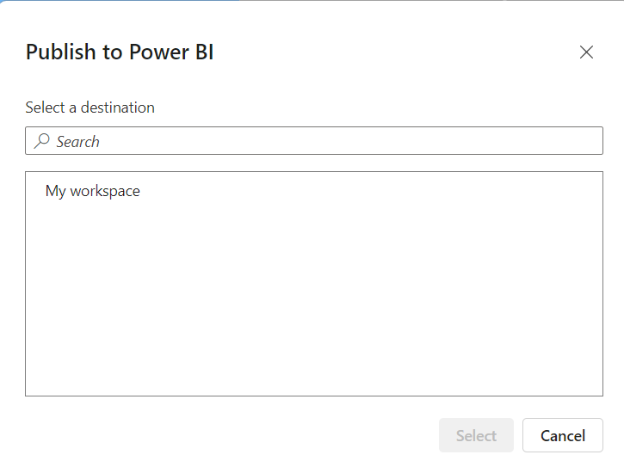
PUBLISH
Next click Home → Publish
Click My workspace → select
Then click open superstore.

Slide 19
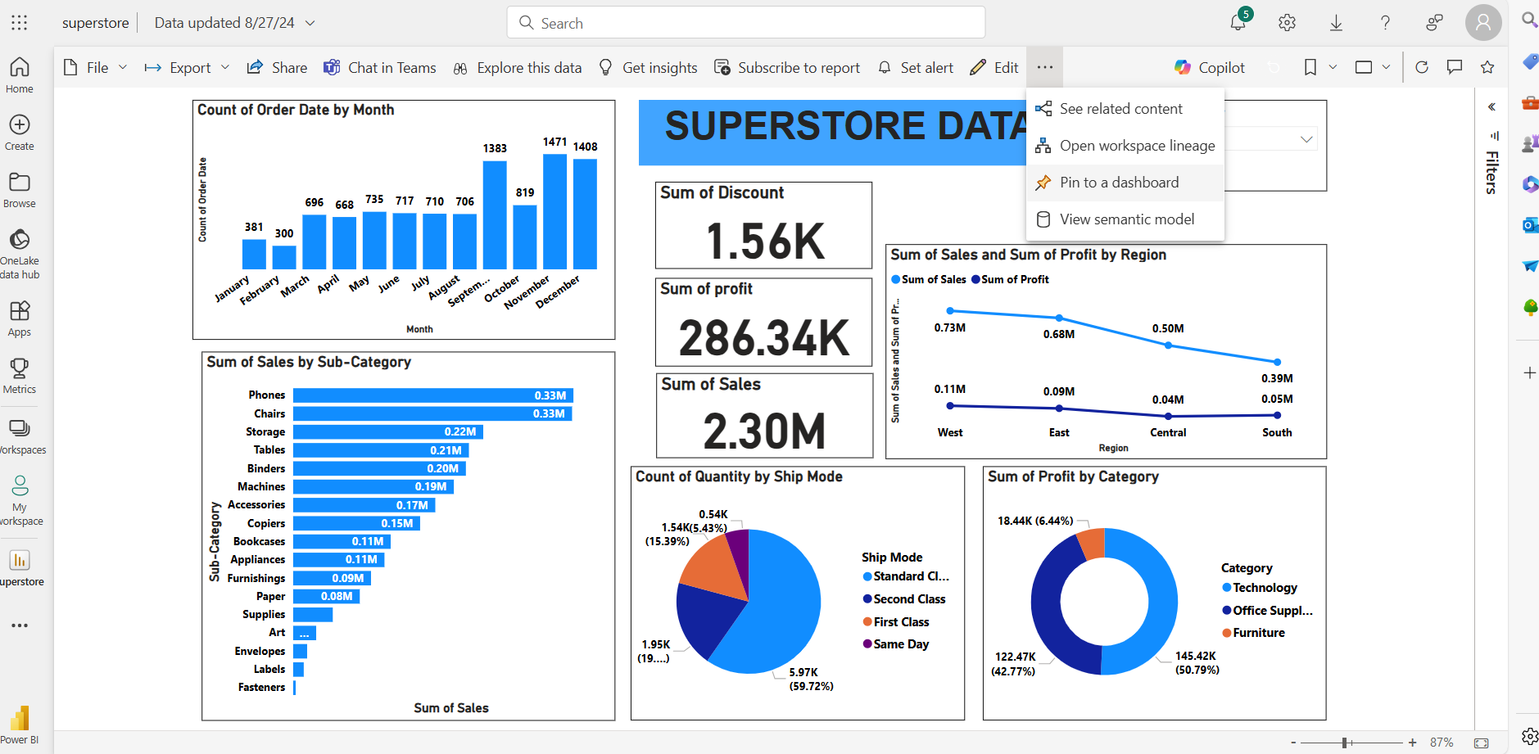
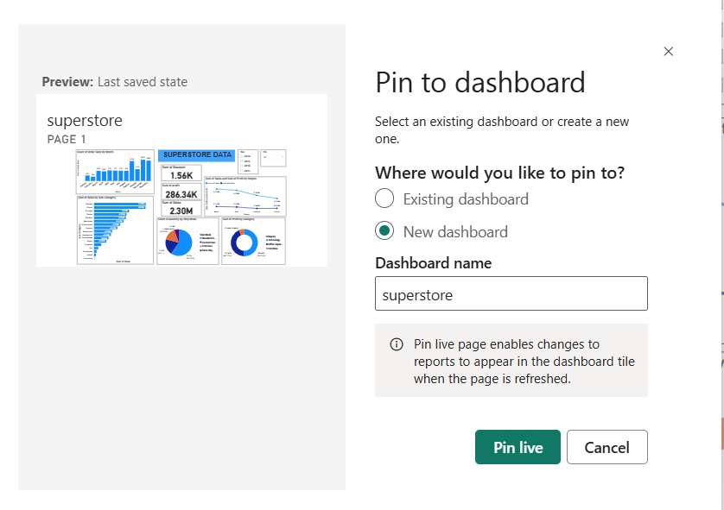
REPORT
Now, we got a report.
Next, click on the three dots → select pin to dashboard.
Then select existing dashboard or new dashboard and click pin live.

Slide 20
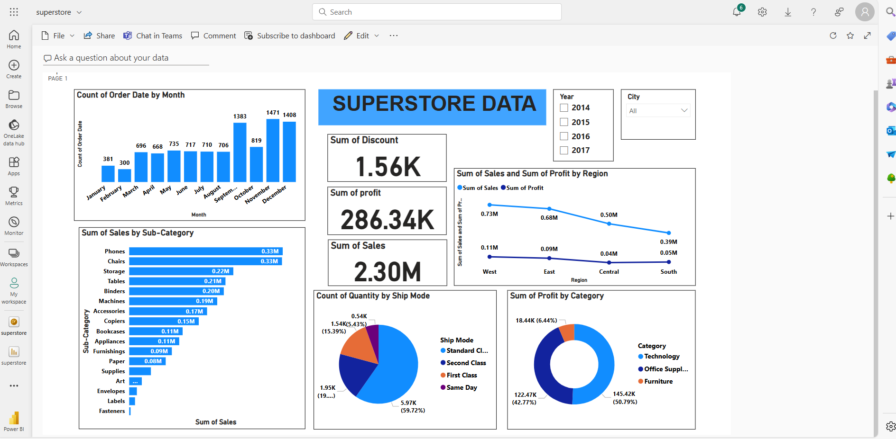
DASHBOARD
We got the dashboard.

Slide 21
THANK YOU!

